Slide 1

Table Relations
Database Design and Rules
SoftUni Team
Technical Trainers
Software University
http://softuni.bg

Slide 2
Table of Content
Database design.
Table Relation.
Retrieving Related Data
Cascade Operations
E/R Diagrams

Slide 3
Questions
sli.do #JavaDB

Slide 4

Database Design
Fundamental Concepts

Slide 5
Steps in Database Design
1
Identification of the entities
2
Defining table columns
3
Defining primary keys
4
Modeling relationships
5
Defining constraints
6
Filling test data

Slide 6
Identification of Entities
Entity tables represent objects from the real world
Most often they are nouns in the specification
For example:
Entities: Student, Course, Town
We need to develop a system that stores information about students, which are trained in various courses. The courses are held in different towns. When registering a new student the following information is entered: name, faculty number, photo and date.

Slide 7
Identification of the Columns
Columns are clarifications for the entities in the text of the specification, for example:
Students have the following characteristics:
Name, faculty number, photo, date of enlistment and a list of courses they visit
We need to develop a system that stores information about students, which are trained in various courses. The courses are held in different towns. When registering a new student the following information is entered: name, faculty number, photo and date.

Slide 8
How to Choose a Primary Key?
Always define an additional column for the primary key
Don't use an existing column (for example SSN)
Must be an integer number
Must be declared as a PRIMARY KEY
Use AUTO_INCREMENT to implement auto-increment
Put the primary key as a first column
Exceptions
Entities that have well known ID, e.g. countries (BG, DE, US) and currencies (USD, EUR, BGN)

Slide 9
Identification of Relationships
Relationships are dependencies between the entities:
"Students are trained in courses" – many-to-many relationship.
"Courses are held in towns" – many-to-one (or many-to-many) relationship
We need to develop a system that stores information about students, which are trained in various courses. The courses are held in different towns. When registering a new student the following information is entered: name, faculty number, photo and date.

Slide 10



Table Relations
Relational Database Model in Action

Slide 11
Relationships
Relationships between tables are based on interconnections: PRIMARY KEY / FOREIGN KEY
Primary key
Foreign key
towns
Primary key
id | name | country_id
1 | Sofia | 1
2 | Varna | 1
3 | Munich | 2
4 | Berlin | 2
5 | Moscow | 3
countries
id | name
1 | Bulgaria
2 | Germany
3 | Russia
Relationships

Slide 12
Relationships (2)
The foreign key is an identifier of a record located in another table (usually its primary key)
By using relationships we avoid repeating data in the database
Relationships have multiplicity:
One-to-many – e.g. mountains / peaks
Many-to-many – e.g. student / course
One-to-one – e.g. example driver / car

Slide 13
One-to-Many/Many-to-One
Primary key
Primary key
Foreign key
Mountains
Peaks
mountain_id | name
1 | Causasus
peak_id | mountain_id
61 | 1
66 | 1
Relation
Notes:
One-to-Many relationship means that each row from a table is related zero, one or many rows in the referent table. In the case above, each mountain can have 0, 1 or many peaks. The example shows that the mountain Caucasus has two peaks - One-to-Many. If you look the other way around many peaks has exactly one mountain – Many-to-One.

Slide 14
Foreign Key
Constraint Name
CONSTRAINT fk_peaks_mountains FOREIGN KEY (mountain_id) REFERENCES mountains(mountain_id);
Foreign Key
Referent Table
Primary Key

Slide 15
Problem: Mountains And Peaks
Create two tables – mountains and peaks
Link their fields properly
Mountains:
Id
name
Peaks:
id
name
mountain_id

Slide 16
Solution: Mountains And Peaks
CREATE TABLE mountains(
id INT PRIMARY KEY AUTO_INCREMENT,
name VARCHAR(50) NOT NULL
);
CREATE TABLE peaks(
id INT PRIMARY KEY AUTO_INCREMENT,
name VARCHAR(50) NOT NULL,
mountain_id INT,
CONSTRAINT fk_peaks_mountains
FOREIGN KEY (mountain_id) REFERENCES mountains(id) );
Primary key
Table Peaks
Foreign Key

Slide 17
Many-to-Many
Primary key
Primary key
employees
projects
employee_id | name
1 | …
40 | …
project_id | name
4 | …
24 | …
Mapping table
employees_projects
employee_id | project_id
1 | 4
40 | 24
Notes:
Many-to-Many relationship relates many rows from a table to many rows in another table. For example. Employee.EmployeeID has many projects. Many projects are assigned to many employees which is the other way around. Usually we have a mapping table that takes care of the relations.

Slide 18
Setup(1)
CREATE TABLE employees(
employee_id INT PRIMARY KEY, employee_name VARCHAR(50)
);
Table Employees
CREATE TABLE projects( project_id INT PRIMARY KEY, project_name VARCHAR(50)
);
Table Projects

Slide 19
Setup(2)
CREATE TABLE employees_projects( employee_id INT, project_id INT,
CONSTRAINT pk_employees_projects
PRIMARY KEY(employee_id, project_id),
CONSTRAINT fk_employees_projects_employees
FOREIGN KEY(employee_id)
REFERENCES employees(employee_id),
CONSTRAINT fk_employees_projects_projects
FOREIGN KEY(project_id)
REFERENCES projects(project_id)
);
Mapping Table
Primary Key
Foreign Key
Foreign Key

Slide 20
One-to-One
Primary key
Primary key
Foreign key
cars
drivers
car_id | driver_id
1 | 166
2 | 102
driver_id | driver_name
166 | …
102 | …
Relation
Notes:
In One-to-One relationship each row of table Cars is related to exactly zero or one row in table Drivers. In table Cars.DriverID is a foreign key which means that there will be a relation to another table – Drivers in the case. Table Drivers has a column DriverID as well which is a primary key. The relation is always between a foreign key and a primary key. It means that all values in Cars.DriverID should be present in Drivers. DriverID except NULL. Cars.DriverID can be NULL if it is not stated otherwise.

Slide 21
Setup
CREATE TABLE drivers(
driver_id INT PRIMARY KEY,
driver_name VARCHAR(50)
);
CREATE TABLE cars(
car_id INT PRIMARY KEY,
driver_id INT UNIQUE,
CONSTRAINT fk_cars_drivers FOREIGN KEY (driver_id) REFERENCES drivers(driver_id)
);
Primary key
One driver
per car
Foreign Key

Slide 22
Foreign Key
Constraint Name
CONSTRAINT fk_cars_drivers FOREIGN KEY (driver_id) REFERENCES drivers(driver_id)
Foreign Key
Referent Table
Primary Key

Slide 23
Table 1
Table 2
Retrieving Related Data
Using Simple JOIN statements

Slide 24
Joins
Table relations are useful when combined with JOINS
With JOINS we can get data from two tables simultaneously
JOINS require at least two tables and a "join condition"
Example:
Select from Tables
SELECT * FROM table_a JOIN table_b ON table_b.common_column = table_a.common_column
Join Condition

Slide 25
Problem: Trip Organization
Write a query to retrieve information about the SoftUni camp’s transportation organization.
Get information about the people who drive(name and age) and their vehicle type
Use database “camp".
Check your solution here: https://judge.softuni.bg/Contests/Practice/Index/748#1

Slide 26
Solution: Trip Organization
Cross Table Selection
SELECT driver_id, vehicle_type,
CONCAT(first_name, ' ', last_name) AS driver_name
FROM vehicles AS v
JOIN campers AS c
ON v.driver_id = c.id;
Join Condition
Check your solution here: https://judge.softuni.bg/Contests/Practice/Index/748#2

Slide 27

Cascade Delete/Update
Cascade Operations

Slide 28
Definition
Cascading allows when a change is made to certain entity, this change to apply to all related entities
Primary key
Foreign key
Primary key
orders
order_items
order_id | order_name
1 | …
22 | …
item_id | order_id
4 | 1
24 | 22
87 | 1
Cascade delete

Slide 29
CASCADE DELETE
CASCADE can be either DELETE or UPDATE.
Use CASCADE DELETE when:
The related entities are meaningless without the "main" one
Do not use CASCADE DELETE when:
You make "logical delete"
You preserve history
Keep in mind that in more complicated relations it won't work with circular references

Slide 30
Problem: Delete Mountains
Write a query to create a one-to-many relationship
When an mountains gets removed from the database, all of his peaks are deleted too
CREATE TABLE `mountains`(
`id` INT PRIMARY KEY AUTO_INCREMENT,
`name` VARCHAR(20) NOT NULL
);

Slide 31
Solution: Delete Mountains (2)
CREATE TABLE `peaks`(
`id` INT PRIMARY KEY AUTO_INCREMENT,
`name` VARCHAR(20) NOT NULL,
`mountain_id` INT,
CONSTRAINT `fk_mountain_id`
FOREIGN KEY(`mountain_id`)
REFERENCES `mountains`(`id`)
ON DELETE CASCADE
);

Slide 32
CASCADE UPDATE
Use CASCADE UPDATE when:
The primary key is NOT identity (not auto-increment) and therefore it can be changed
Best used with UNIQUE constraint
Do not use CASCADE UPDATE when:
The primary is identity (auto-increment)
Cascading can be avoided using triggers or procedures

Slide 33
Foreign Key Delete Cascade
CREATE TABLE drivers(
driver_id INT PRIMARY KEY,
driver_name VARCHAR(50)
);
CREATE TABLE cars(
car_id INT PRIMARY KEY,
driver_id INT,
CONSTRAINT fk_car_driver FOREIGN KEY(driver_id)
REFERENCES drivers(driver_id) ON DELETE CASCADE );
Table Drivers
Table Cars
Foreign Key

Slide 34
Foreign Key Update Cascade
CREATE TABLE drivers(
driver_id INT PRIMARY KEY,
driver_name VARCHAR(50)
);
CREATE TABLE cars(
car_id INT PRIMARY KEY,
driver_id INT,
CONSTRAINT fk_car_driver FOREIGN KEY(driver_id)
REFERENCES drivers(driver_id) ON UPDATE CASCADE );
Table Drivers
Table Cars
Foreign Key

Slide 35
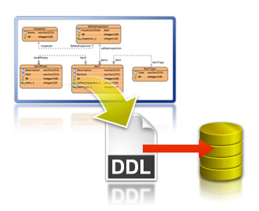
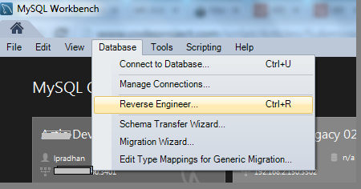
Entity / Relationship Diagrams
E/R Diagrams
Notes:
E/R diagrams represent the tables which are called entities and the relationships between them. They are used as a technical illustration of the database design.
To Do: snip how to create e/r diagram.

Slide 36
Relational Schema
Relational schema of a DB is the collection of:
The schemas of all tables
Relationships between the tables
Any other database objects (e.g. constraints)
The relational schema describes the structure of the database
Doesn't contain data, but metadata
Relational schemas are graphically displayed in Entity / Relationship diagrams (E/R Diagrams)

Slide 37
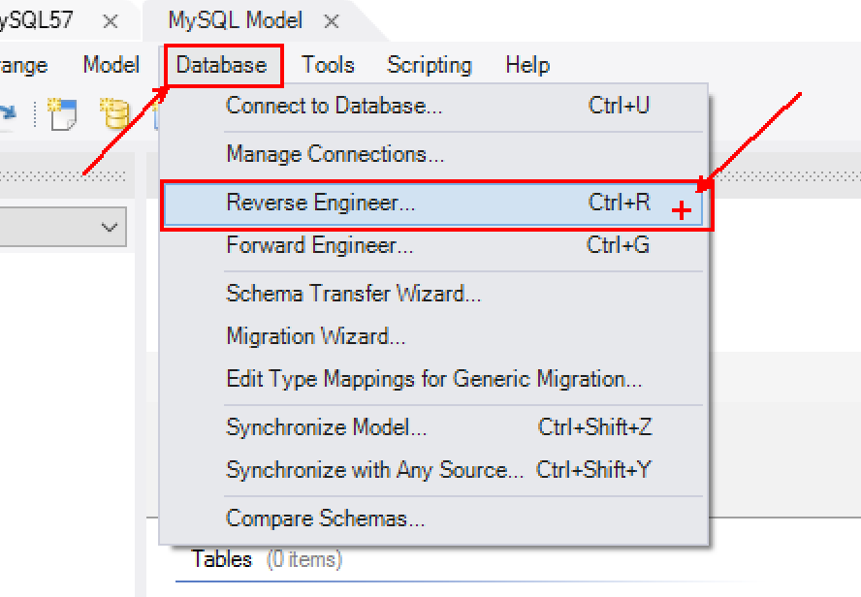
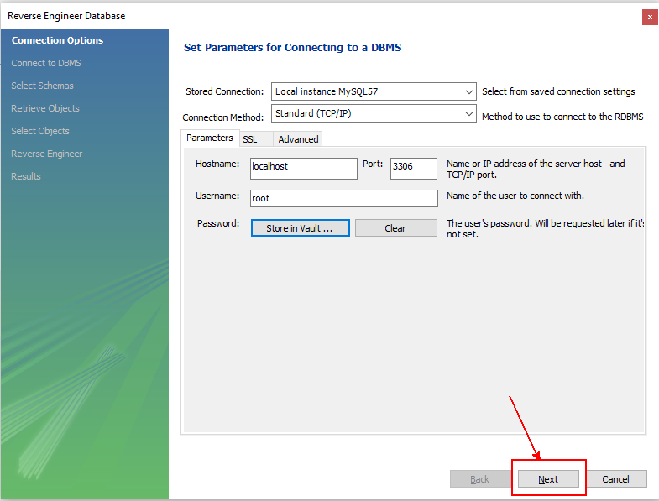
E/R Diagram
Click on "Database" then select "Reverse Engineer"

Slide 38
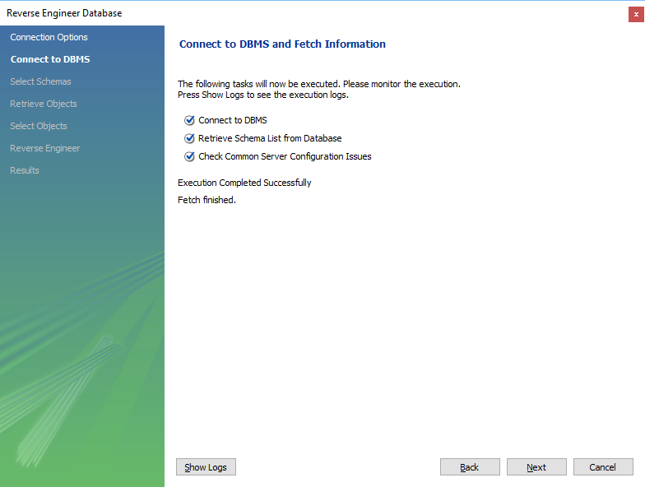
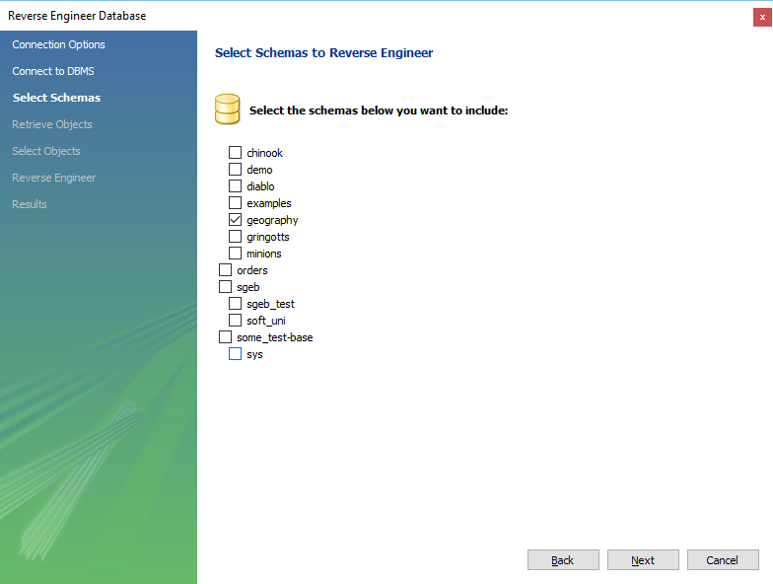
E/R Diagram

Slide 39
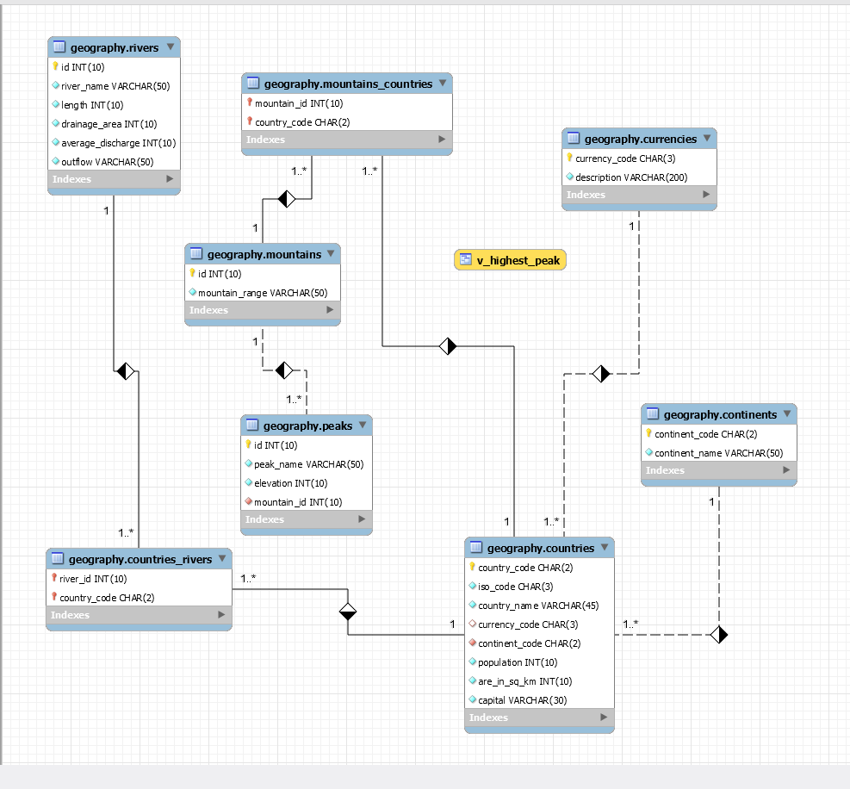
E/R Diagram

Slide 40

Summary
…
…
…
We design databases by specification entities and their characteristics
Types of relations:
One-to-one
One-to-many
Many-to-many
We visualize relations via E/R diagrams

Slide 41
https://softuni.bg/trainings/courses

Slide 42













SoftUni Diamond Partners

Slide 43





SoftUni Organizational Partners

Slide 44




Trainings @ Software University (SoftUni)
Software University – High-Quality Education and Employment Opportunities
softuni.bg
Software University Foundation
http://softuni.foundation/
Software University @ Facebook
facebook.com/SoftwareUniversity
Software University Forums
forum.softuni.bg

Slide 45

License
This course (slides, examples, demos, videos, homework, etc.) is licensed under the "Creative Commons Attribution-NonCommercial-ShareAlike 4.0 International" license

